Slide 1
PI Vision Extensibility, Creating a Custom Symbol
Alex Riveron – Product Support Engineer II, Visualization
Menotti Aristone – Sr Product Support Engineer I, Visualization

Slide 2
Course Overview
This lab is designed for developers who are interested in creating custom symbols for PI Vision. In this lab we will explain the PI Vision Extensibility framework and go through the creation of a basic symbol. PI Vision extensibility heavily relies on JavaScript, HTML and CSS. An understanding of AngularJS and jQuery is also recommended.

Slide 3
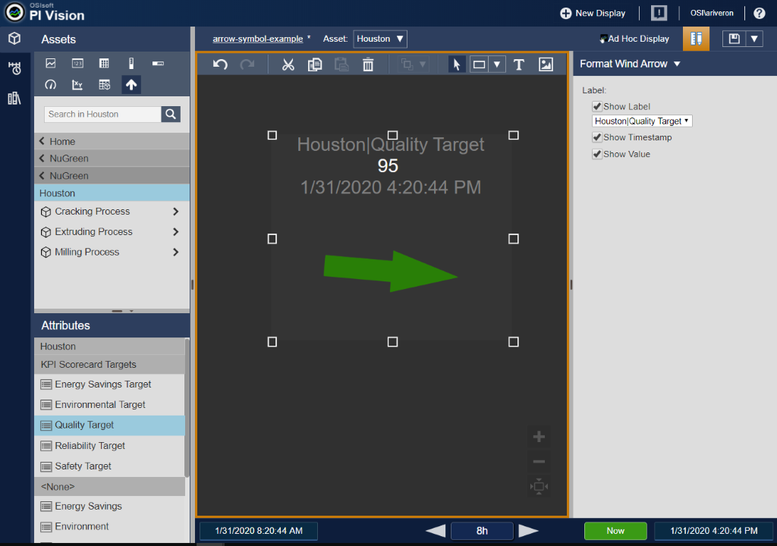
Arrow Indicator Symbol
The symbol we will be creating in this lab is an arrow indicator. That symbol consists of an arrow that’s position is based off the value of the data item and a configuration pane that can toggle the data item path, value, and timestamp on and off.

Slide 4
Connecting to Your Lab VLE
Locate the slip of paper on your desk that indicates your client number.
Step by Step:
Open Remote Desktop on your PC
Enter the connection string you were provided for your Client machine (“PICLIENT##”) and click OK
Log into the machine
UserID: pischool\student##
Password: TBD

Slide 5

Getting Started
Enable Compilation debug mode to prevent file minification
system.web/compilation
Create the ext folder to house the custom symbols
%PIHOME64%\PIVision\Scripts\app\editor\symbols\ext\

Slide 6
Parts of a PI Vision Symbol
Implementation
JavaScript file with three parts
Definition
Initialization
Registration
Naming convention: sym-<symbol name>.js
Presentation
HTML template file & CSS
Naming convention: sym-<symbol name>-template.html
Configuration
HTML template file & CSS
Responsible for configuration pane
Naming convention: sym-<symbol name>-config.html

Slide 7
Implementation - Definition
Create the JavaScript file using correct naming convention and place in the ext folder
Define the immediately invoked function expression (IFFE)
Define visualization object and use the PV.deriveVisualizationFromBase() method to add default symbol behavior

Slide 8
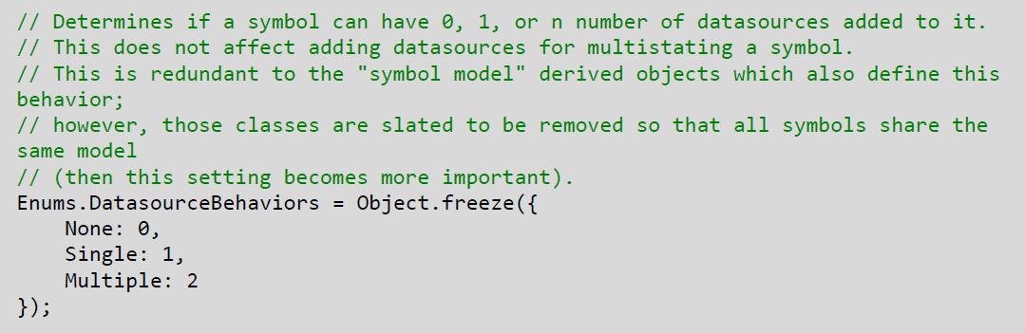
Implementation – Definition cont.
Define the symbol definition object with required properties
typeName: Unique name for symbol
visObjectType: symbol object from previous step (symbolVis)
iconUrl: path to image to display in Vision symbol selector
datasourceBehavior: number of allowed data sources
Determined by object in \Scripts\app\common\PIVisualization.enumerations.js

Slide 9
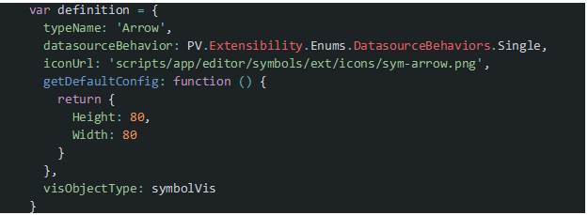
Implementation – Definition cont.
Define the symbol definition object with required properties
getDefaultConfig
Method that returns an object specifying default configuration
Need to define Height and Width for symbol to appear

Slide 10
Implementation – Initialization & Registration
Define the symbol’s prototype initialization method
Register the symbol with the PV.symbolCatalog.register() method

Slide 11
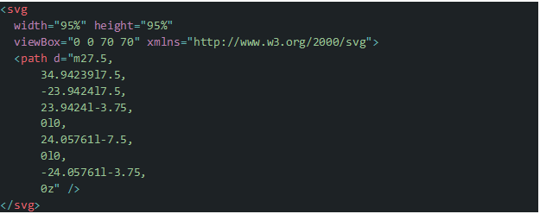
Presentation
Create HTML template file using correct naming convention and place in the ext folder
Create SVG element and use the path element to create the arrow

Slide 12
Exercise 1: Create and Load Symbol
Page 11 of Workbook
Objectives:
Create the symbol implementation file to load a symbol
Create the symbol template file to display an arrow
Test the newly created symbol using PI Vision
Time for Exercise: 30 min

Slide 13
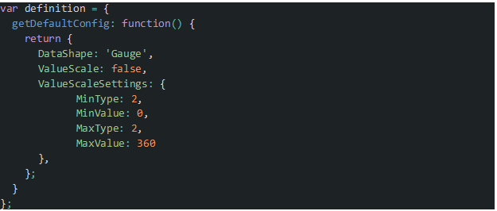
PI Vision Data Shapes
Data shape determines the type of information returned by Vision’s data calls
Defined in the symbol definition
Value, Gauge, Trend, Table, TimeSeries
Arrow indicator will use the Gauge data shape
Other shapes properties available in the Extensibility Guide

Slide 14
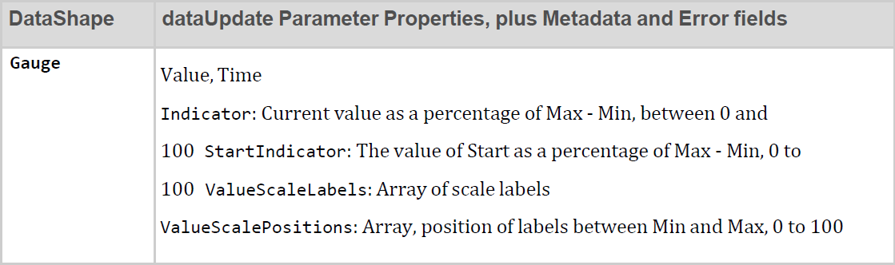
PI Vision Data Updates
This.onDataUpdate(data)
Callback function which returns data that is placed within the symbol.prototype.init(scope,element) method
Data object properties determined by data shape

Slide 15
PI Vision Data Update Metadata
Metadata is only returned on first request and periodically afterwards
Data update code should only process the following fields if they exist in the data response:
Path
Label
Units
DataType (Included if configuration object has DataType set to true)
Description (Included if configuration object has Description set to true)

Slide 16
Exercise 2: Update Symbol with Data
Page 17 of Workbook
Objectives:
Specify data shape for symbol
Create data update listener
Rotate the arrow based on the data update
Time for Exercise: 20 min

Slide 17
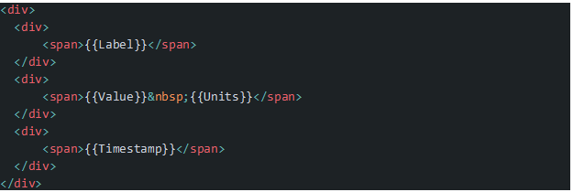
Updating Presentation through Scope and AngularJS
Symbols Scope can be used with AngularJS to update the symbol’s HTML
Data binding done through {{ }} notation
Recommended to use this to update symbol properties like Value, Label, and Timestamp

Slide 18
Exercise 3: Show Value, Timestamp, Label and Units
Page 23 of Workbook
Objectives:
Store the latest value and timestamp data updates in symbol scope
Store the latest label and units in symbol scope
Update the symbol template to display the value, timestamp, label, and units
Time for Exercise: 20 min

Slide 19
Configuration
Create HTML template file using correct naming convention and place in the ext folder
Create INPUT elements of type checkbox to toggle the symbol properties on and off (ngModel directive can be useful here)
Specify a configOptions function in your symbol definition to configure the right click menu

Slide 20
Exercise 4: Create a Configuration Pane
Page 33 of Workbook
Objectives:
Add user options for showing label, value, and timestamp
Conditionally show the label, value, and timestamp based on the user options
Create the configuration pane to allow the user to toggle the options
Expose the configuration pane through the symbol’s context menu
Time for Exercise: 20 min

Slide 21
Adding CSS to custom symbols
Create the CSS file and place in the ext folder. We do not need a specific naming convention for CSS files.
Add appropriate context to Presentation and Configuration HTML files for use with your CSS

Slide 22
Exercise 5: Add Styles to Symbol and Configuration Pane
Page 35 of Workbook
Objectives:
Add class attributes to elements
Create the CSS file
Configure styles through the CSS file
Time for Exercise: 15 min

Slide 23




Have a question or technical issue?
Ask The Community on
Ask an Engineer from
Notes:
Segway “And if you can’t figure out the issue yourself…”

Slide 24
What information does Tech Support need?
A clear description of the issue
Product and version information
Relevant information (e.g. logs, steps to reproduce issue, OS version)
Urgency and Impact
PI Server Serial #

Slide 25

Evaluation
Please take a few minutes to fill in the evaluation form (links provided on the desktop of the Virtual Learning Environment):
https://osisoft.az1.qualtrics.com/jfe/form/SV_1Tc407dAFmYgJlr

Slide 26

Save the Date
OSIsoft PI World Users Conference in Amsterdam; October 26-29, 2020.
Register your interest now to receive updates and notification of early bird registration opening.
https://pages.osisoft.com/UC-EMEA-2020-Q4-10-26-PI-World-AMS-Register-Your-Interest_Register-Your-Interest.html

Slide 27


Slide 28







Merci
Thank You
Grazie
Optional: Click to add a takeaway you wish the audience to leave with.

